Slide 1
Introduction to Statistical Methods
ISM Team

Slide 2

Lead Faculty: Dr. G Krishna Kumari (gkrishnakumari@wilp.bits-pilani.ac.in)
Session 12
(24th July 2026)
Prediction and Forecasting

Slide 3
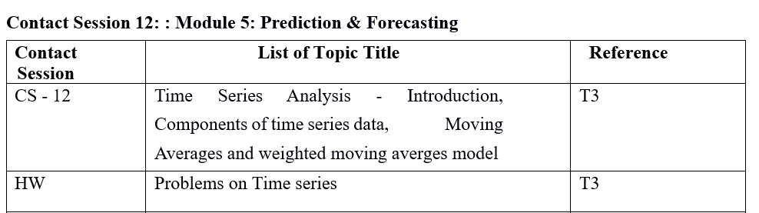
Contact Session 12

Slide 4


Case Study
Scenario 1: A teacher collects study hours and marks obtained by student's data.
Study Hours (X) | Marks (Y)
2 | 40
4 | 55
6 | 70
8 | 85
Examine the two datasets provided. Explain how they differ and decide which statistical method should be used to analyze each dataset.
Scenario 2: A college records number of student admissions every year.
Year | Admissions
2020 | 450
2021 | 480
2022 | 520
2023 | 580
2024 | 610

Slide 5
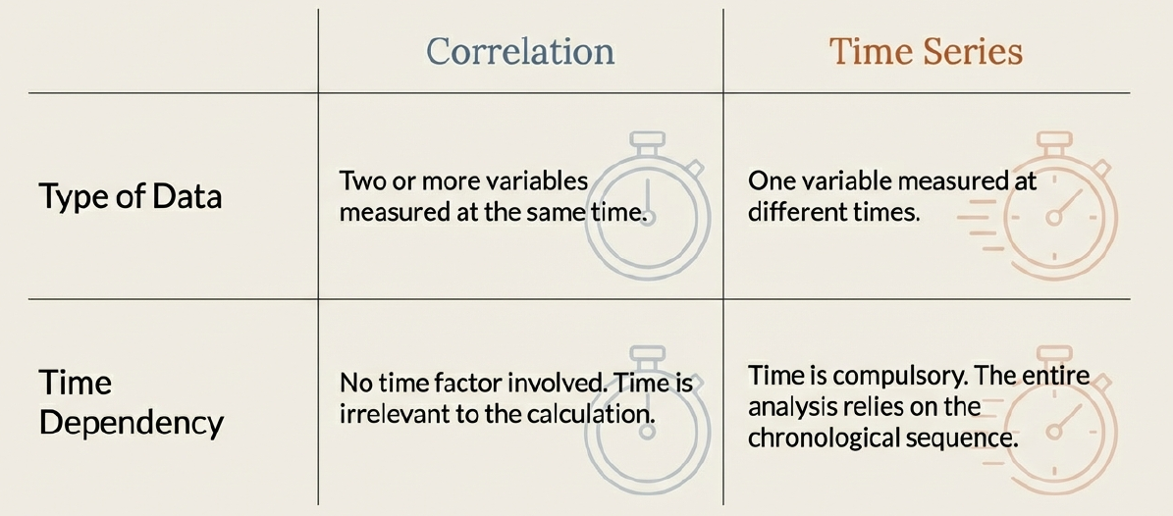
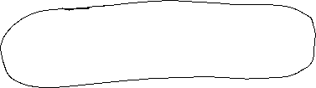
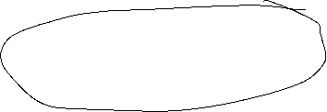
Correlation Vs Time Series

Slide 6
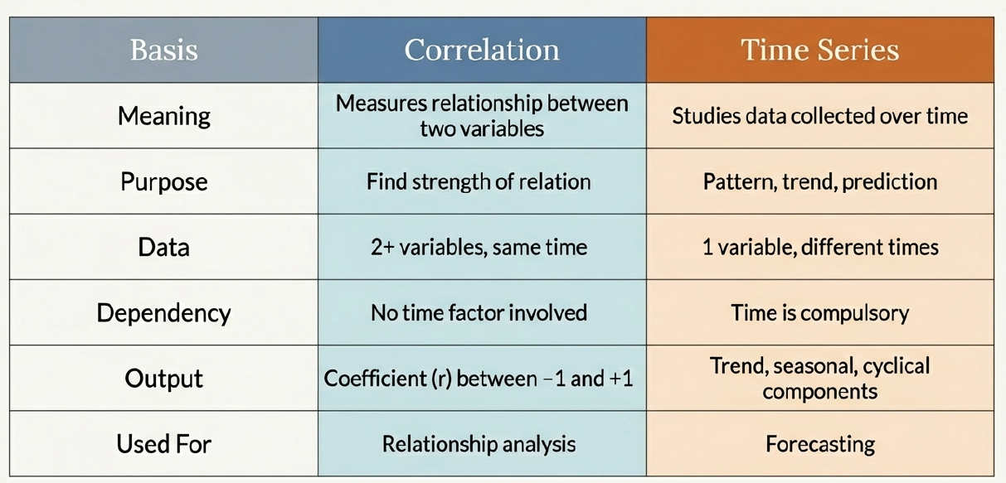







Correlation Vs Time Series

Slide 7
Agenda
Introduction to Time Series
Components of Time Series
Moving Average Model
Weighted Moving Average Model

Slide 8
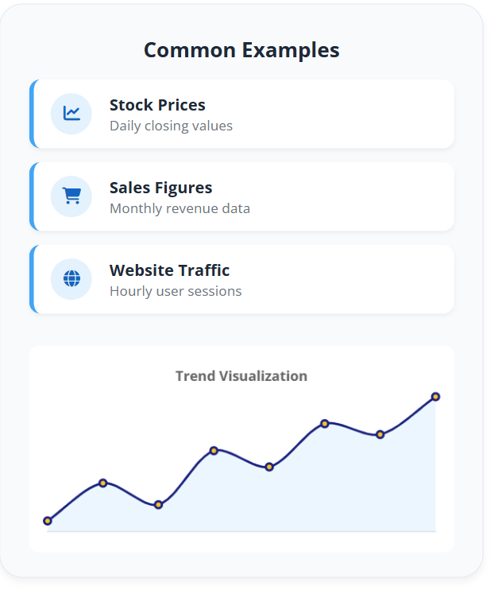



Introduction to Time Series
Definition: A sequence of data points or observations measured at successive, equally spaced intervals of time (t = 1, 2, …). It focuses on understanding how a variable changes over time.
Key Terms
Observation (Y_{t})
Time Index (t)
Lag (k)
Frequency (e.g., Daily)
Primary Goals
Describe: Identify patterns like trends, cycles, and seasonality.
Smooth: Filter out random noise to reveal the underlying signal.
Forecast: Predict future values based on historical patterns.

Slide 9
Introduction to Time Series
A time series is defined as a set of observations on a variable generated sequentially in time. The measurement of the variable are made at discrete (equally spaced) intervals.
Often a variable continuous in time is measured at regular intervals and this produces a discrete series of data. Such data may be collected at regular time intervals such as, monthly, weekly, quarterly or annually.
Time series are used in statistics, econometrics, mathematical finance, weather forecasting, earthquake prediction and many other applications.

Slide 10

Introduction to Time Series
Time series may be represented as a set of data (Y₁, Y₂, Y₃, …, Y_{n}), Y_{t} denoting the value of the variable Y at time t.
A discrete time series data may be generated from the accumulation of data over a period of time.
Example of continuous variable:
Temperature on a chemical reactor
Level of tide at a particular site
Amplitude of an electrical signal
Example of discrete variable:
Monthly sales
Daily rainfall
Production of a crop over different years in a country

Slide 11
Decomposition of Time Series
Decomposition is an important technique for all types of time series analysis.
It is used to reconstruct the original time series by additions or multiplications of component where each of these has a certain characteristic or type of behaviour.
Time series are usually decomposed into:
Trend
Seasonal
Cyclical
Irregular

Slide 12
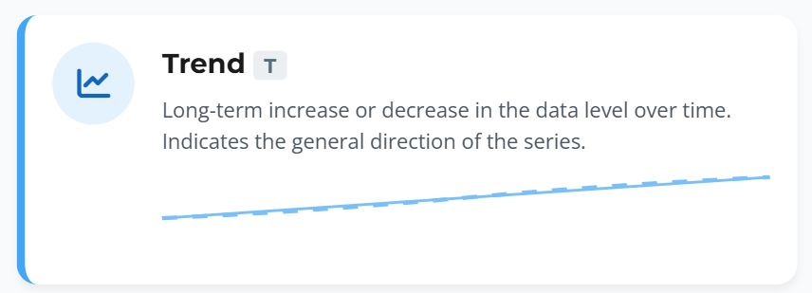
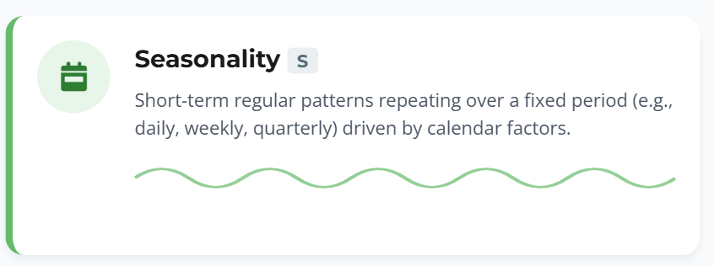
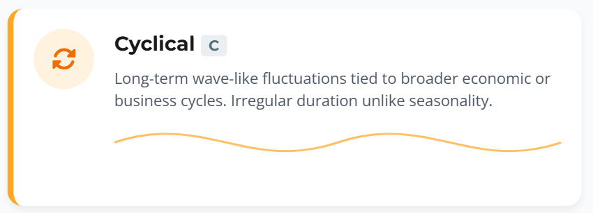
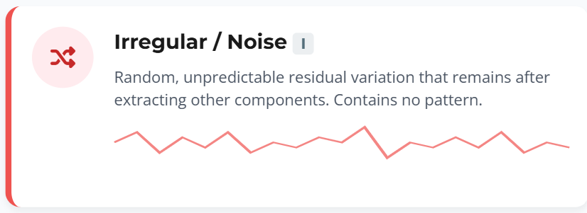




Decomposition/Components of Time Series

Slide 13







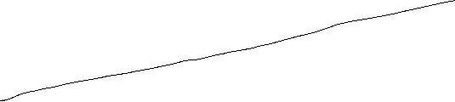

Trend component
T_{t}: the trend component at time t, which reflects the long-term progression of the series (secular variation).
A trend exists when there is a persistent increasing or decreasing direction in the data. The trend component does not have to be linear
Trend measure the change in the mean level of the time series.
Persistent, overall upward or downward pattern
Several years duration
Indicates long term movements in the level of the series.
Mo., Qtr., Yr.

Slide 14
Seasonal component
S_{t} (seasonality): the seasonal component at time t.
A seasonal pattern exists when a time series is influenced by seasonal factors. Seasonality occurs over a fixed and known period (e.g., the quarter of the year, the month, or day of the week).
Generally within a year or shorter we get seasonal component in the series.
The seasonal variation of a time series is a pattern of change that recurs regularly over time.
Seasonal variations are usually due to the differences between seasons and to festive occasions such as Hindu, Christian or Muslim festivals.
Examples include:
Air conditioner sales in Summer
Heater sales in Winter
Flu cases in Winter
Airline tickets for flights during school vacations

Slide 15
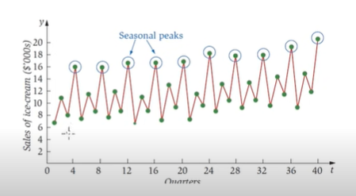
Seasonal Component
Seasonality in a time series can be identified by regularly spaced peaks and troughs which have a consistent direction and approximately the same magnitude every year, relative to the trend.
The following diagram depicts a strongly seasonal series. There is an obvious large seasonal increase in December retail sales in New South Wales due to Christmas shopping. In this example, the magnitude of the seasonal component increases over time, as does the trend.

Slide 16
Cyclic component
C_{t}: the cyclical component at time t.
which reflects repeated but non-periodic fluctuations.
The duration of these fluctuations are extended over a long period. Usually are longer than a year.
Cyclical variations also have recurring patterns but with a longer and more erratic time scale compared to Seasonal variations.
The name is quite misleading because these cycles can be far from regular and it is usually impossible to predict just how long periods of expansion or contraction will be.
There is no guarantee of a regularly returning pattern.

Slide 17
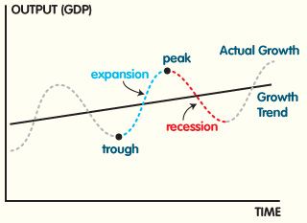
Cyclic component
Examples:
Floods
Wars
Changes in interest rates
Economic depressions or recessions
Changes in consumer spending
This chart represents an economic cycle, but we know it doesn’t always go like this. The timing and length of each phase is not predictable.

Slide 18
Difference Between Seasonal and Cyclic Components
Feature | Seasonal Component | Cyclic Component
Definition | A repeating pattern that occurs at fixed, regular intervals (e.g., daily, monthly, yearly). | A fluctuating pattern that occurs at irregular intervals and is influenced by external factors like economic cycles.
Periodicity | Fixed and known (e.g., quarterly, annual, weekly). | Variable and unpredictable (can last several years).
Cause | Usually driven by natural, social, or institutional factors (e.g., weather, holidays). | Driven by economic, political, or business cycles.
Duration | Short-term and repeats within a fixed period. | Long-term and may not have a fixed period.
Examples | - Higher ice cream sales in summer. - Increased shopping in December (holiday season). | - Stock market fluctuations. - Economic recessions and expansions.

Slide 19
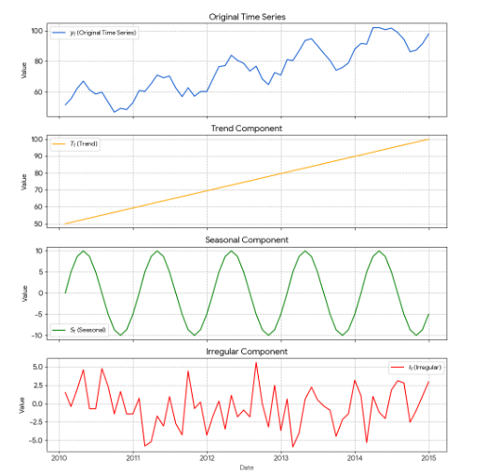
Irregular component
I_{t}: the irregular component (or "noise") at time t.
which describes random or short term unpredictable fluctuations.
It represents the residuals or remainder of the time series after the other components have been removed.

Slide 20
Irregular component
An irregular (or random) variation in a time series occurs over varying (usually short) periods.
It follows no pattern and is by nature unpredictable.
It usually occurs randomly and may be linked to events that also occur randomly.
Irregular variation cannot be explained mathematically.
If the variation cannot be accounted for by secular trend, season or cyclical variation, then it is usually attributed to irregular variation.
Examples:
Sudden changes in interest rates
Collapse of companies
Natural disasters
Sudden shift s in government policy
Dramatic changes to the stock market
Effect of Middle East unrest on petrol prices.

Slide 21
Irregular component
Erratic, unsystematic, ‘residual’ fluctuations
Due to random variation or unforeseen events like Union strike, War Short duration & nonrepeating
Rapid changes or bleeps in the data caused by short term unanticipated and non-recurring factors. Irregular fluctuations can happen as often as day to day
The irregular component results from short term fluctuations in the series which are neither systematic nor predictable. In a highly irregular series, these fluctuations can dominate movements, which will mask the trend and seasonality.

Slide 22
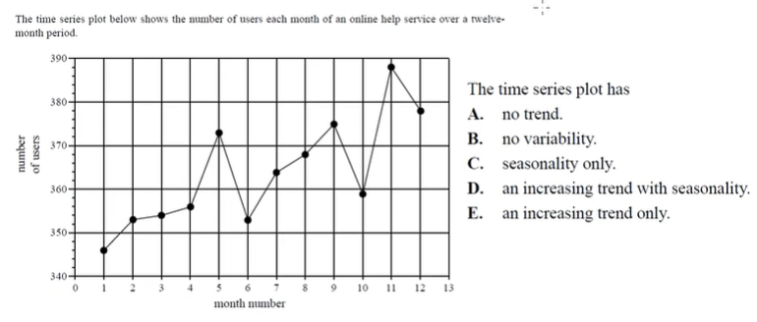
Learning Check
Answer: E

Slide 23
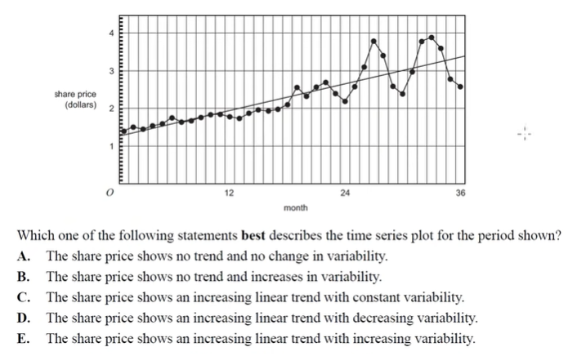
Learning Check
Answer: E

Slide 24
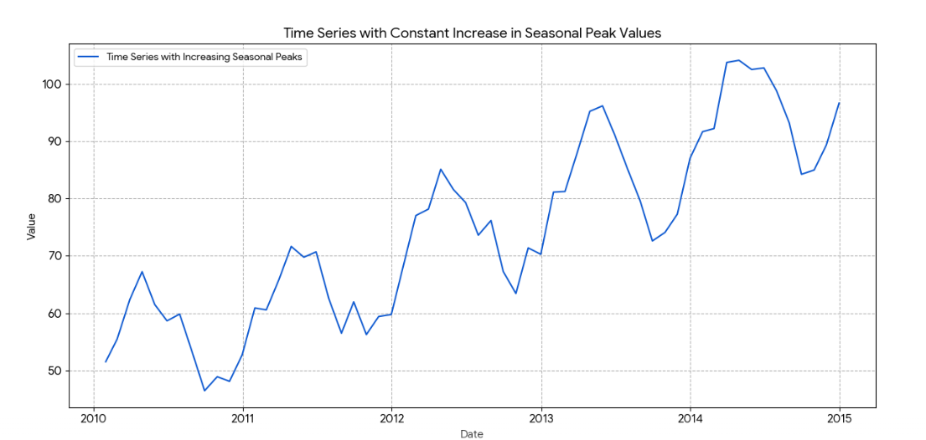
Additive model
y_{t} = T_{t} + C_{t} + S_{t} + I_{t}
Characteristics:
The seasonal variations remain constant over time.
Suitable when seasonal fluctuations are of roughly equal magnitude, regardless of the trend level.
Used when data exhibits linear patterns.
Example:
If ice cream sales increase by 100 units every summer regardless of the overall trend, an additive model is appropriate.

Slide 25
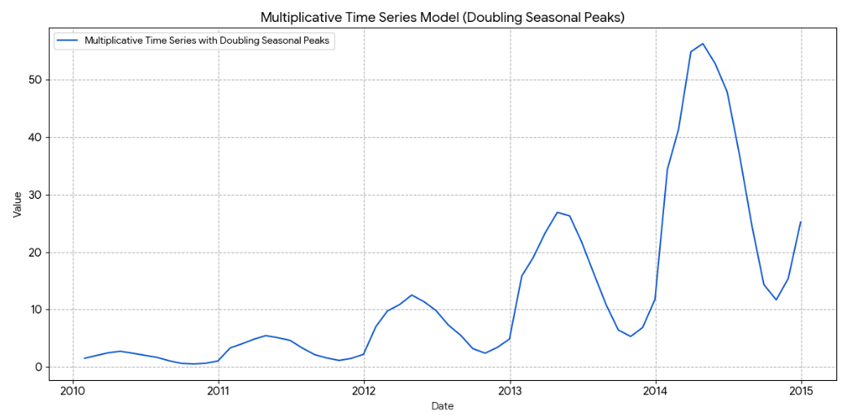
Multiplicative model
y_{t} = T_{t} x C_{t} x S_{t} x I_{t} or equivalently, log⁡(y_{t})=log⁡(T_{t})+log⁡(C_{t})+log⁡(S_{t}) +log⁡(I_{t}) (after taking logarithm, it transforms into an additive form).
Characteristics:
The seasonal variations change in proportion to the trend (i.e., they grow or shrink as the trend changes).
Suitable for data where seasonal effects increase or decrease with the level of the series.
Used when data exhibits exponential growth patterns.
Example: If ice cream sales double every summer relative to the previous year’s sales, a multiplicative model is more suitable.

Slide 26
Key Differences
Feature | Additive Model | Multiplicative Model
Formula | y_{t} = T_{t} + C_{t} + S_{t} + I_{t} | y_{t} = T_{t} x C_{t} x S_{t} x I_{t}
Seasonality | Constant magnitude | Varies with trend (proportional)
Trend | Linear | Exponential or non-linear
When to Use | Seasonal variations are stable | Seasonal variations change with trend
Graph Behavior | Seasonal pattern remains constant | Seasonal amplitude increases/decreases over time
Choosing Between the Two:
Use the additive model when seasonal fluctuations are independent of trend magnitude.
Use the multiplicative model when seasonal variations increase or decrease as the trend changes.
If unsure, visualize the data: if seasonal patterns appear to grow with time, the multiplicative model is likely the better choice.

Slide 27
Difference Between Forecasting and Prediction
Criteria | Forecasting | Prediction
Definition | Estimating future events based on past data, patterns, and trends using statistical models or quantitative analysis. | Making judgments or guesses about future events, often without relying heavily on historical data or models.

Slide 28
Forecasting
Forecasting is the process of making predictions of the future based on past and present data and most commonly by analysis of trends.
Forecasts can be required several years in advance.
Forecasting is required in many situations:
(a) deciding whether to build another power generation plant in the next five years requires forecasts of future demand.
(b) scheduling staff in a call centre next week requires forecasts of call volumes
(c) stocking an inventory requires forecasts of stock requirements. etc.
Whatever the circumstances or time horizons involved, forecasting is an important aid to effective and efficient planning.

Slide 29
Forecasting
Some things are easier to forecast than others.
The time of the sunrise tomorrow morning can be forecast precisely.
On the other hand, tomorrow’s iPhone sale cannot be forecast with any accuracy.
Forecasting depends on several factors including:
how well we understand the factors that contribute to it;
how much data is available;
whether the forecasts can affect the thing we are trying to forecast.
Forecasts of the time of the sunrise tomorrow morning, electricity demand can be highly accurate because all three conditions are usually satisfied.
Forecasting currency exchange rates, only one of the conditions is satisfied: there is plenty of available data. However, we have a limited understanding of the factors that affect exchange rates.

Slide 30
Forecasting, Planning and Goals
Forecasting:
is about predicting the future as accurately as possible, given all of the information available, including historical data and knowledge of any future events that might impact the forecasts
Planning:
is a response to forecasts and goals. Planning involves determining the appropriate actions that are required to make your forecasts match your goals.
Goals:
are what you would like to have happen. Goals should be linked to forecasts and plans, but this does not always occur. Too often, goals are set without any plan for how to achieve them, and no forecasts for whether they are realistic.

Slide 31
Forecasting frame
Short-term Forecasts
Short-term forecasts generally involve some form of scheduling which may include for example the seasons of the year for planning purposes.
The cyclical and seasonal factors are not more important in these situations.
Such forecasts are usually prepared every 6 months or on a more frequent basis.
These forecasts are needed for the scheduling of personnel, production and transportation. As part of the scheduling process, forecasts of demand are often also required.

Slide 32
Forecasting frame
Medium-term Forecasts
Medium-term forecasts are generally prepared for planning, scheduling, budgeting and resource requirements purposes.
Medium-term forecasts are needed to determine future resource requirements, in order to purchase raw materials, hire personnel, or buy machinery and equipment.
The trend factor, as well as the cyclical component, plays a key role in the medium-term forecast as the year to year variations in traffic growth are an important element in the planning process

Slide 33
Forecasting frame
Long-term Forecasts
Long-term forecasts are used mostly in connection with strategic planning to determine the level and direction of capital expenditures and to decide on ways in which goals can be accomplished.
The trend element generally dominates long term situations and must be considered in the determination of any long-run decisions.
The methods generally found to be most appropriate in long-term situations are econometric analysis and life‑cycle analysis. Long-term forecasts are used in strategic planning. Such decisions must take account of market opportunities, environmental factors and internal resources.
It is also important that since the time span of the forecast horizon is long, forecasts should be calibrated and revised at periodic intervals (every two or three years depending on the situation).

Slide 34
Forecasting Methods
Forecasting Methods
Qualitative
Quantitative
Personal Opinion or Judgment
Panel consensus
Delphi Method
Market Research
Time Series
Causal
Smoothing methods
Exponential smoothing
Trend projection method
Regression Trend Analysis

Slide 35
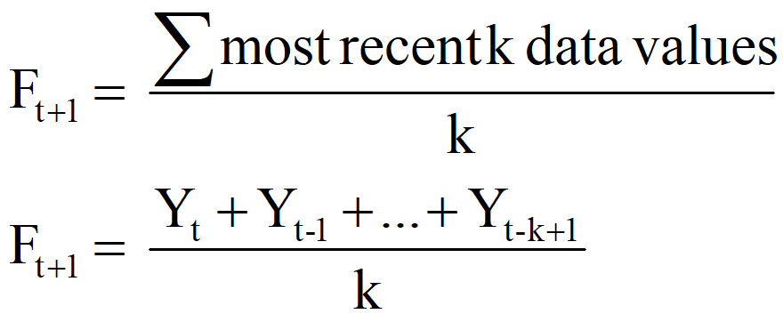
Smoothing Techniques – Moving Averages
Appropriate for a time series with a horizontal pattern ie., the data that are stationary.
Moving Average (the average of the most recent k data values forms the forecast for the next period)

Slide 36
Key Differences
Feature | Moving Average (MA) | Centered Moving Average (CMA)
Definition | A method that averages past data points over a fixed window to smooth fluctuations. | A refined version of MA that aligns the smoothed values to the center of the window.
Formula
Positioning of Values | The average is placed at the end of the window. | The average is placed at the center of the window.
Use Case | Used for short-term forecasting and smoothing noisy data. | Used primarily for smoothing the time series.
Effect on Trend | Introduces a lag since it is calculated using past values. | Better aligns with the actual values by placing the average in the correct time period.
Window Type | Uses past values only (trailing moving average). | Uses both past and future values (symmetric window).
Example |  | 4-period CMA: Calculate 2-period MA first, then average adjacent MA values to align to the center.

Slide 37
Measurement of forecast error
What was forecasted
to happen at time t using the
forecast technique
Forecast
Error
at time t
Δ _{t} = y_{t} - F_{t}
What actually
happened
at time t

Slide 38
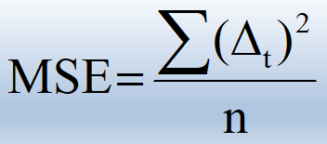
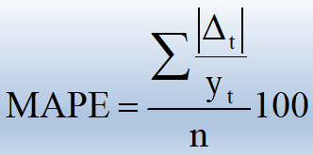
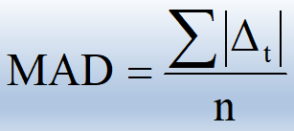
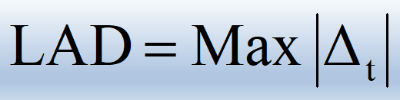
Performance Measures
Mean Square Error (MSE)
Mean Absolute Percent
Error (MAPE)
Mean Absolute Deviation
(MAD)
Largest Absolute Deviation
(LAD)

Slide 39
Choice of the Performance Measure
Which performance should be used?
Advantages
MSE gives greater weight to larger deviations (which could result from outliers)
MAD gives less weight to larger deviations
MAPE gives less overall weight to a large deviation if the time series value is large
LAD tells us if all deviations fall below some threshold value
Although we illustrate all 4 techniques, in general focus will be on MSE and MAD.

Slide 40
Simple Moving Average
The idea behind the moving averages is that observations which are nearby in time are also likely to be close in value.
The average of the points near an observation will provide a reasonable estimate of the trend-cycle at that observation.
The average eliminate some of the randomness in the data, and leaves a smooth trend-cycle component.
It is assumed that fluctuations are around some base(level) line.
If we take more data for average then we get more smooth curve.
Thus method require more data for better forecast.
If we take one year moving average, it’s a naive forecast.

Slide 41
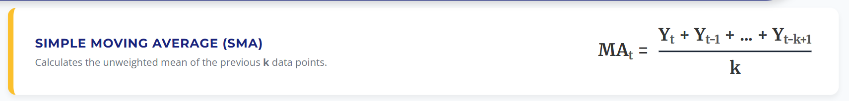
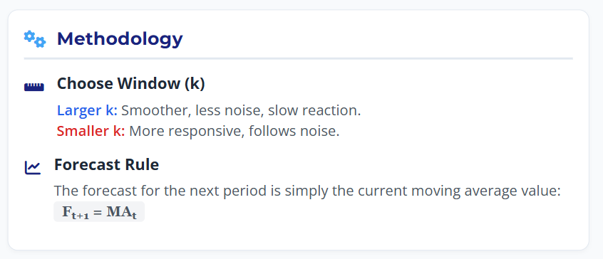
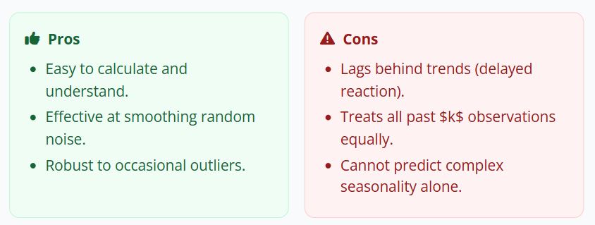
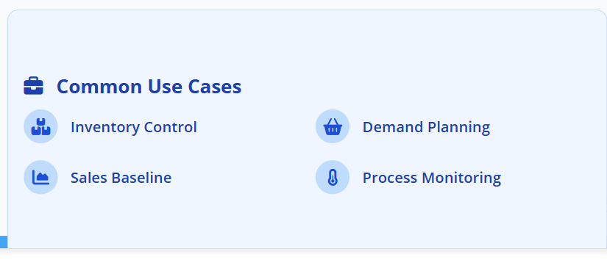
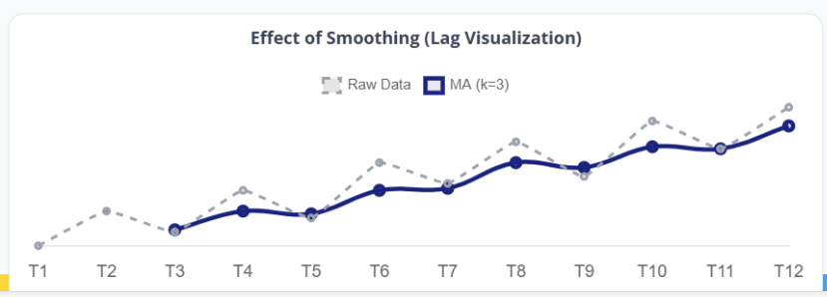
Simple Moving Average

Slide 42
Example 1
Following data shows production volume (in ‘000 tones). Compute 3-year centre moving average for all available years
Year | Production | 3 - year moving total | 3 - year moving average
1995 | 21
1996 | 22 | 66 | 22.00
1997 | 23 | 70 | 23.33
1998 | 25 | 72 | 24.00
1999 | 24 | 71 | 23.67
2000 | 22 | 71 | 23.67
2001 | 25 | 73 | 24.33
2002 | 26 | 78 | 26.00
2003 | 27 | 79 | 26.33
2004 | 26

Slide 43
Example 2
Following data shows production volume (in ‘000 tones). Compute 3 and 5-year moving average
Period (t) | Sales (Y_{t})
1 | 5.3
2 | 4.4
3 | 5.4
4 | 5.8
5 | 5.6
6 | 4.8
7 | 5.6
8 | 5.6
9 | 5.4
10 | 6.5
11 | 5.1
12 | 5.8
13 | 5
14 | 6.2
15 | 5.6
16 | 6.7
17 | 5.2
18 | 5.5
19 | 5.8
20 | 5.1
21 | 5.8
22 | 6.7
23 | 5.2
24 | 6
25 | 5.8
3yr MA
5.03
5.20
5.60
5.40
5.33
5.33
5.53
5.83
5.67
5.80
5.30
5.67
5.60
6.17
5.83
5.80
5.50
5.47
5.57
5.87
5.90
5.97
5.67
5yr MA
5.30
5.20
5.44
5.48
5.40
5.58
5.64
5.68
5.56
5.72
5.54
5.86
5.74
5.84
5.76
5.66
5.48
5.78
5.72
5.76
5.90

Slide 44
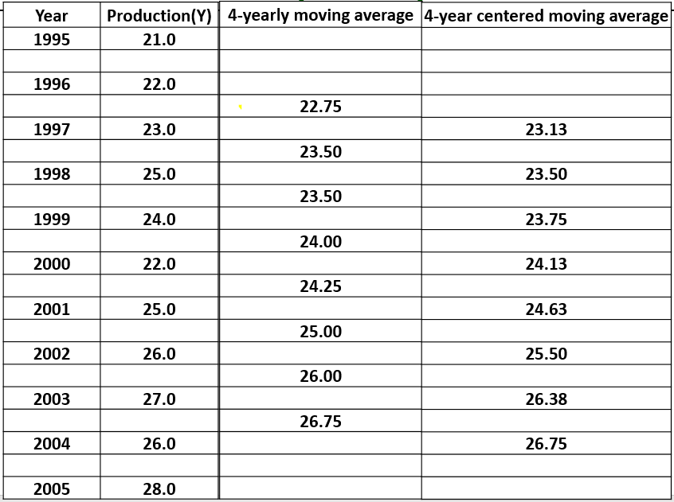
Example 3
Following data shows production volume (in ‘000 tones). Compute 4-year centered moving average

Slide 45
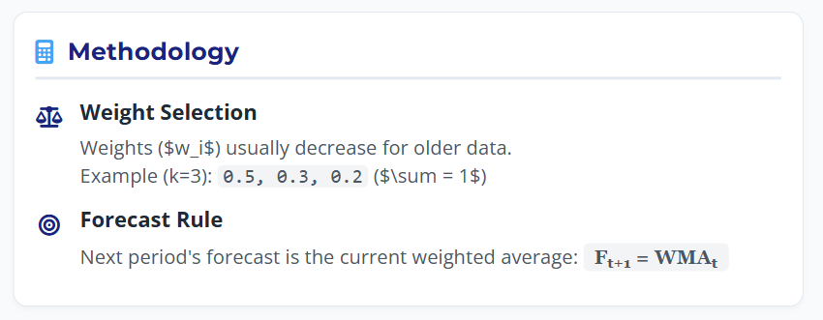
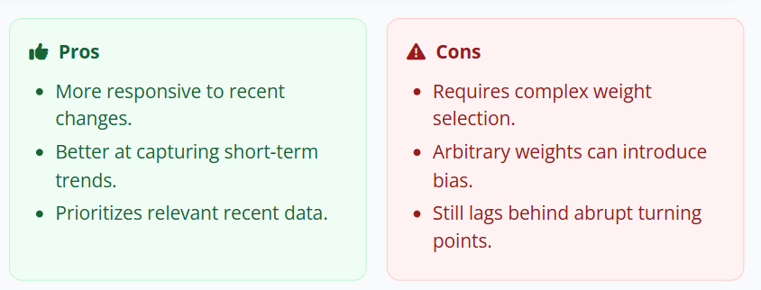
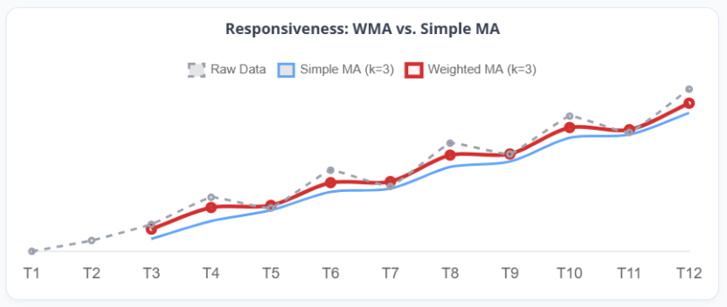
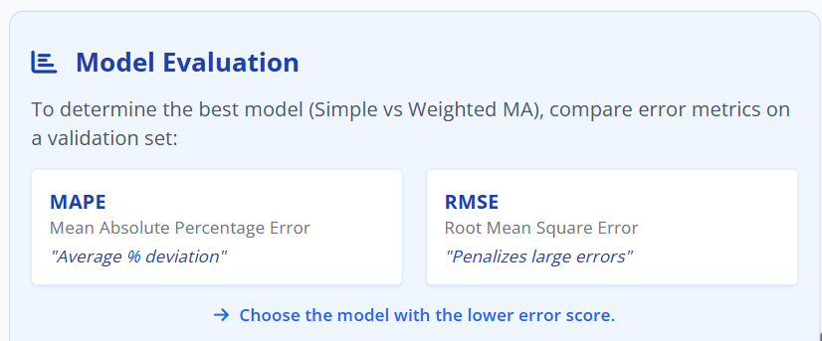
Weighted Moving Average
0.5, 0.3, 0.2 (sum = 1)

Slide 46
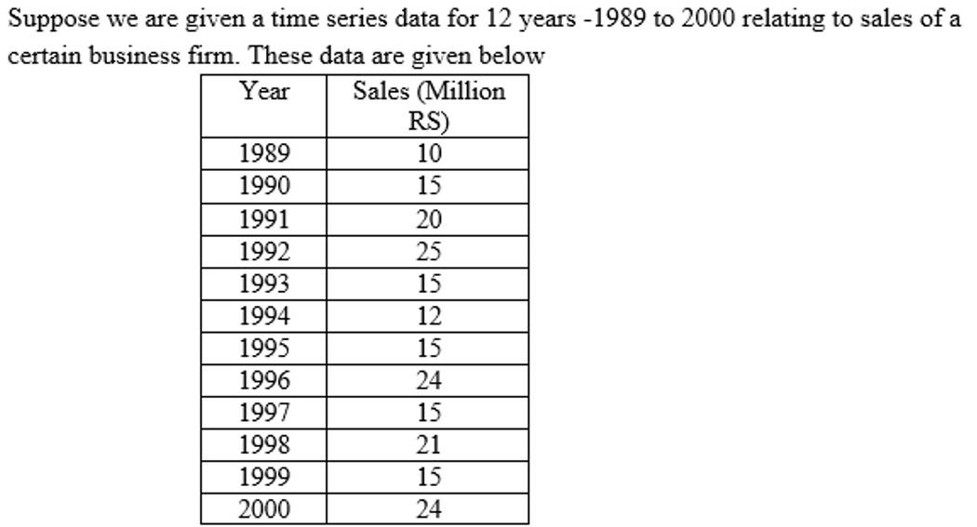
Practice Problem -1
Find out the 3 year centered moving averages

Slide 47
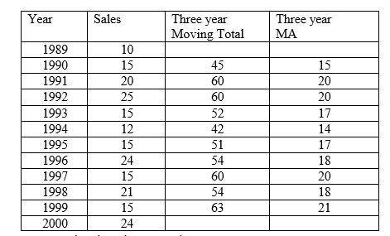
Solution:

Slide 48
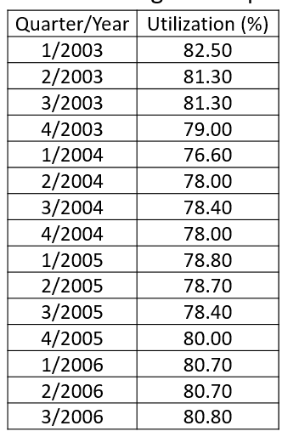
Practice problem-2
The following data represent 15 quarters of manufacturing capacity utilization
Find the 2,3 & 4 quarter moving average

Slide 49
Thanks

